Slide 1
ASP.NET MVC
Model-View-Controller, ASP.NET MVC Routing,
JQuery and AJAX, Validation, Unit Tests
Polina Nikolova
MCTS, MCPD

Slide 2
Table of Contents
Comparing WebForms to ASP.NET MVC
What is ASP.NET MVC?
Routing
Controllers
Views
Models
JQuery and AJAX
Validation
Unit Tests

Slide 3
Comparing WebForms to ASP.NET MVC

Slide 4
ASP.NET WebForms
Rich controls and tools
Postbacks
Event driven web development
Viewstate
Less control over the HTML
Hard to test
Rapid development

Slide 5
ASP.NET MVC
More control over HTML
No Codebehind
Separation of concerns
Easy to test
URL routing
No postbacks
No ViewState

Slide 6
What is ASP.NET MVC?

Slide 7
Model – View - Controller
Controller - responsible for handling all user input
Model - represents the logic of the application
View - the visual representation of the model
Controller
(Input)
Model
(Logic)
View
(Presentation)

Slide 8
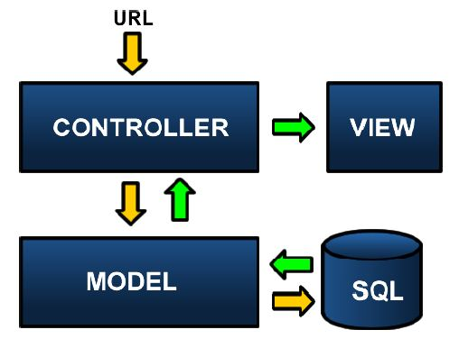
Page Lifecycle

Slide 9
Routing

Slide 10
Routing
The Routing module is responsible for mapping incoming browser requests to particular MVC controller actions.
Two places to setup:
Web.config file
Global.asax file

Slide 11
Routing Setup
Web.config file
<system.web>
<httpModules>
…
<system.webServer> <modules> …
<system.web>
<httpHandlers> …
<system.webServer> <handlers> …

Slide 12
Routing Setup
Global.asax file
public class MvcApplication : System.Web.HttpApplication
{
public static void RegisterRoutes(RouteCollection routes)
{
routes.IgnoreRoute("{resource}.axd/{*pathInfo}");
routes.MapRoute(
"Default",
"{controller}/{action}/{id}",
new { controller = "Home",
action = "Index", id = "" }
);
}
protected void Application_Start()
{
RegisterRoutes(RouteTable.Routes);
}
}

Slide 13
URL Example
http://www.mysite.com/Home/About/6
{controller} = Home
{action} = About
{id} = 6

Slide 14
Controllers

Slide 15
What is Controller?
It is a class
Derives from the base System.Web.Mvc.Controller class
Generates the response to the browser request
[HandleError]
public class HomeController : Controller
{
public ActionResult Index()
{
ViewData["Message"] = "Welcome to ASP.NET MVC!";
return View();
}
public ActionResult About()
{
return View();
}
}

Slide 16
Controller Actions
Public method of the Controller class
Cannot be overloaded
Cannot be a static method
Returns action result
public ActionResult About()
{
return View();
}

Slide 17
Action Results
Controller action response to a browser request
Inherits from the base ActionResult class
Different results types

Slide 18
Action Results Types
ViewResult
EmptyResult
RedirectResult
JsonResult
JavaScriptResult
ContentResult
FileContentResult
FilePathResult
FileStreamResult

Slide 19
Controller base class methods
View
Redirect
RedirectToAction
RedirectToRoute
Json
JavaScriptResult
Content
File

Slide 20
Views

Slide 21
Views
Most of the Controller Actions return views
The path to the view is inferred from the name of the controller and the name of the controller action.
\Views\ControllerName\ControllerAction.aspx
A view is a standard (X)HTML document that can contain scripts.
script delimiters <% and %> in the views

Slide 22
HTML Helpers
Method that generates View Content – typically return string.
Use it for generating standard HTML elements
textboxes, dropdown lists, links etc.
Example: Html.TextBox() method
Using HTML Helper methods is optional
You can create your own HTML Helpers

Slide 23
Pass Data to a View
ViewData – used to pass data from the Controller to the View
ViewData["message"] = "Hello World!";
Strongly typed ViewData
ViewData.Model = OurModel;

Slide 24
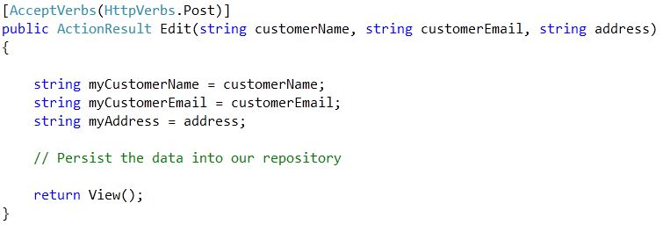
Post data to a controller
[AcceptVerbs(HttpVerbs.Post)]
The action method in the controller accepts the values posted from the view.
The view form fields must match the same names in the controller.

Slide 25
Models

Slide 26
Models
The model should contain all of the application business logic, validation logic, and database access logic.
ASP.NET MVC is compatible with any data access technology (for example LINQ to SQL)
All .edmx files, .dbml files etc. are located in the Models folder.

Slide 27
Custom ViewModels
Combine LINQ data and custom static or dynamic data
Pass the CustomModel to the View
ViewData.Model = customModel;
Implement the view without using any typecasts
Inherits="System.Web.Mvc.ViewPage<CustomModel>“
<%= Model.UserName %>

Slide 28
JQuery and AJAX

Slide 29
JQuery and AJAX
Form validation
if ($("#inputId").val() == "") {
alert("message");
}
Submit forms
jQuery methods that can perform AJAX request
$. ajax(), $.get( ) , $.post( ) , $.getJSON( ), $. getScript(), $.load()
Asynchronous HTTP (Ajax) request

Slide 30
Ajax request example
$(function() {
$("#submitButtonId").click(function(ev) {
ev.preventDefault();
AjaxPost(CallbackResult);
});
});
function AjaxPost(ajaxCallback) {
var form = $("#SubmitFormId");
if (form) {
var errorMsg = ValidateSubmit();
if (errorMsg == "") {
var action = "/ControllerName/ControllerAction";
var serializedForm = form.serialize();
$.post(action,
serializedForm,
ajaxCallback);
}
else {
alert(errorMsg);
}
}
}
function CallbackResult(result) {
var data = eval("(" + result + ")");
if (data.IsValid == true) {
window.location.reload();
}
else {
var message = "Not valid";
alert(message);
}
}
Returns Json
if (Request.IsAjaxRequest())
// process the data
return Json(new {IsValid = isValidData});

Slide 31
Validation

Slide 32
Validation
Two types of validation error messages
generated before the HTML form fields are bound to a class
generated after the form fields are bound to the class
Model State
Validation Helpers
Html.ValidationMessage()
Html.ValidationSummary()

Slide 33
Unit Tests

Slide 34
Unit Tests
Unit Tests are for the business logic, not for the data access logic or the view logic.
Test individual unit of code
Make the code safe to modify
Mock Object framework
Moch your database
Create mocks for the classes in the application
Write code that uses the mock objects

Slide 35
ASP.NET MVC

Slide 36
Useful sites
http://www.asp.net/mvc
http://msdn.microsoft.com/en-us/library/dd394709.aspx
http://stackoverflow.com/
http://jquery.com/

